Slide 1

Automated Image Captioning
By Roja Sahoo
2021111014
CSD
roja.sahoo@research.iiit.ac.in

Slide 2

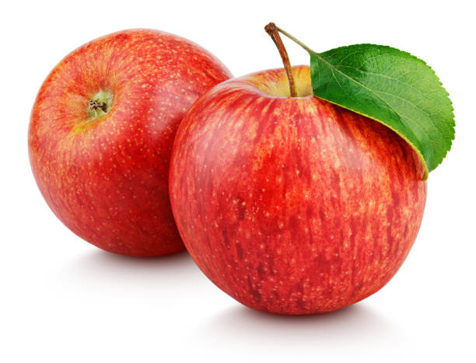
What is automated image captioning?
i/p
o/p
This is an image of two red apples.
It is the ability of a machine to generate a natural description of an image.

Slide 3
Used pretrained models to classify and describe an image
CLIP
&
GPT2

Slide 4
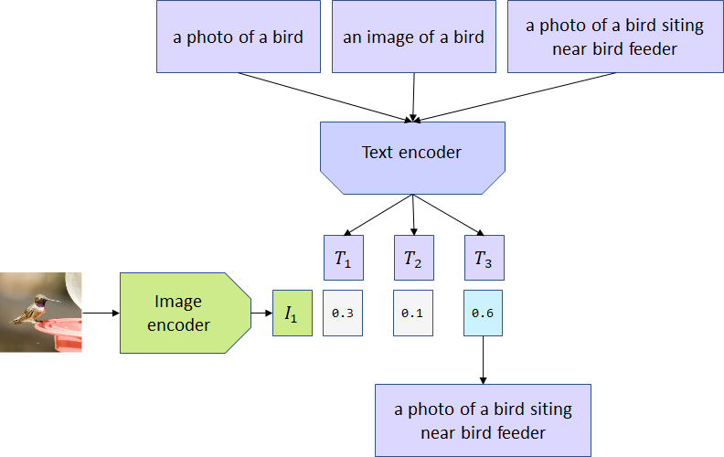
Why CLIP?
CLIP by OpenAI, links images to text by encoding both types of data into one similar representation where they can be compared.

Slide 5
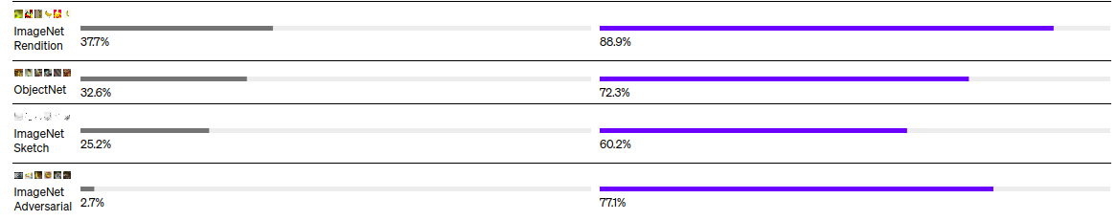
4 times more efficient at zero-shot ImageNet accuracy when compared to other methods
Dataset Other Model Accuracy CLIP Accuracy
However it only identifies objects in the image, so we still need to generate such a text that could potentially describe the image

Slide 6
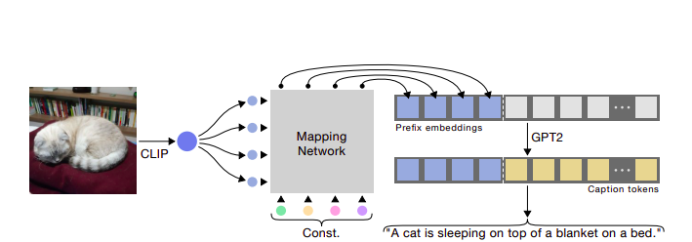
GPT2
The task of describing the actions in an image, can be performed by a language model like GPT-2.
We employ GPT-2 to generate the caption given the prefix embeddings by CLIP.

Slide 7
Implementation Steps
1. Load the required transformers, ML models and python libraries.
2.Define classes for CLIP and GPT2+MLP, and fix hyperparameters.
6.Display generated caption
3.Define generate_caption function, which uses our supermodel(CLIP+GPT2)
5.Load model weights and upload your image.
4.Choose pretrained model on COCO or conceptual captions
https://colab.research.google.com/drive/1UNsEQr7xyUMQFdyc8Hh1s-67bZQku1j1#scrollTo=6bi_2zQ3QD57

Slide 8
generate_caption
generate_beam
This is the main function that generates the captions.
It weighs the best probabilities of the recognized tokens and gives the most probable output.
Beam search is a heuristic search algorithm that explores a graph by expanding the most promising node in a limited set.
What we get is a list of possible captions from the best one.

Slide 9
Implementation Details
Prefix Length
10
Batch
Size
40
We observed that increasing the size of the prefix length, up to a certain value, improves the performance of the model in an underlying task.
Epoch Num
10
Learning
Rate
0.00002
We constrained it to 10 to abide by the memory space.
Optimizer
AdamW
The smaller learning rate and batch size allows for optimal set of weights to be determined.
Max Caption Size
67
AdamW allows for quicker training of the mapping.

Slide 10
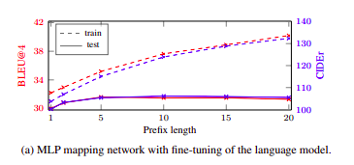
Results
Conceptual Captions consists of a wider variety of styles than COCO (common objects in context).
Model successfully identifies uncommon objects even when trained only over COCO.
Bilingual Evaluation Understudy Score, or BLEU for short, is a metric for evaluating a generated sentence to a reference sentence.

Slide 11
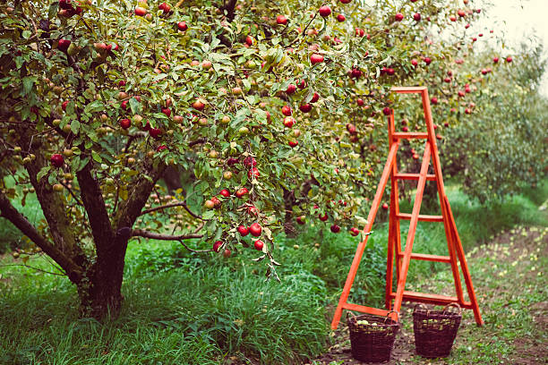


Image
Conceptual Captions
COCO
Red apples in the apple tree.
A tree with a ladder and a red apple tree next to it.
Group of business people working in the office.
A group of people sitting around a table with laptops.
Person, a student, smiles during a graduation ceremony.
A woman wearing glasses and a shirt and tie.

Slide 12

Difficulties Faced
Training usually takes a lot of time, this was resolved using doing it only for the mapping and using pretrained models.
High quality/detailed images took longer to process.
Sometimes the extrapolation led to blank/simple images being described wrongly.

Slide 13

Future Scope
Improve Object Detection
CLIP struggles with slightly complex tasks such as counting the number of objects in an image, predicting how far an object is from the camera (no sense of depth perception) and telling differences between similar objects.
3D Translation
Can be modified to perform other challenging tasks, such as visual question answering or image to 3D translation.
Paper Referred: https://arxiv.org/pdf/2111.09734.pdf

Slide 14
Applications
Help the Visually Impaired
Would serve as a huge help for visually impaired people. Lots of applications can be developed in that space.
Social Media
Commonly used in social media platforms to improve user experience and engagement. Adding relevant captions to images makes them more searchable and improves content discovery.
Marketing and Advertisements
It can be employed in generating captions for marketing materials, advertisements, or storytelling purposes
Content Moderation
This can be useful in applications such as content moderation, image recognition, visual surveillance, and object detection, where understanding the visual context is crucial.

Slide 15
Thank You
Questions?

